Slide 1
HOUSE FLY
Eggs whitish 1mm long several batches of up to 150 on rotting materials or animal faeces. Hatch 8 hours/to 2 days.
Larvae-legless maggots up to 12 mm long in groups on semi-liquid food-3 moults usually develop in 1-2 weeks-move away from food when fully developed.
Pupae-inside reddish oviod puparia in soil or dry area, develop in 1-2 weeks.
Adults 6mm greyish with pale stripes on thorax. Pale yellow underside of abdomen/wings spread slightly when at rest. Large red eyes.
Notes:
Habit: Very common worldwide often in association with human activity. Adults active fliers, highly mobile and capable of travelling several miles. Breed usually in rotting vegetable matter or animal faeces.
Importance: Disease transmission, spoilage of food, nuisance. May be severe problem in animal units and sometimes refuse tips.
Control: Breeding reduction by covering larval food materials, good hygiene. Larvicides and biological control in animal units. Adults by proofing, screening windows, traps. Knockdown pyrethoroids. Bait formulations of residual insecticides in animal units. Adults by proofing, screening windows, traps. Knockdown pyrethroids. Bait formulations of residual insecticides in animal units.

Slide 2
FRUIT FLY
Egg – larva – pupa – adult.
Eggs about 500 eggs per female, approx. 20 per day on suitable food material depending on species.
Larvae – small legless maggots, 3 moults, develop in few days. Move to drier area when fully developed.
Pupae – in brownish puparia, develop in a few days.
Adults – 2 mm, greyish with large (red) eyes.
Notes:
Habit: Very common outdoors and may come indoors to breed. Several species usually breeding on rotting vegetable matter, fruit, sour milk, beer, vinegar. Very rapid breeders (one generation in 7-8 days at 30 degrees c).
Importance: Potential disease transmission, nuisance. Difficult to removal pupal cases from milk bottles.
Control: Good hygiene, find breeding sites and cover or remove breeding materials. Knockdown sprays may be of a limited efficacy.

Slide 3
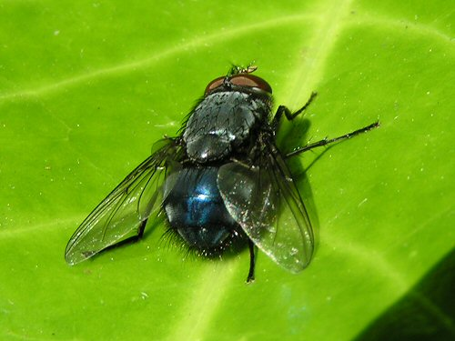
BLUEBOTTLE
Eggs whitish 1mm long several
batches of up to 150 on animal tissue
- fresh or cooked meat.
Hatch 12- 24 hours depending on temperature.
Larvae-legless maggots up to 18 mm
long in groups on food source -3
moults usually develop in 1-2 weeks-
move away from food when fully
developed.
Pupae-inside reddish ovoid puparia in
soil or dry area, develop in 1-2 weeks.
Adults 10mm blue thorax and abdomen. Large red eyes.
Notes:
Habit: Common world wide and in association with man. Adults active fliers, travel several miles. Bluebottle will enter buildings readily to find breeding sites. Breed in carcasses, meat, offal, meat products.
Importance: Potential disease transmission. Pest of meat industry, slaughter houses. May breed on dead rodents, birds within buildings. Also valuable re-cyclers of dead animal material.
Control: Screens, good hygiene, covering potential breeding materials. Residual or knockdown insecticides. UV light devices in food premises.

Slide 4
LARDER BEETLE
Eggs- up to 200 per female laid singly on larval food over 6 month period. hatch in 1 week.
Larvae(woolly bear)-up to 14mm long dark brown banded with distinctive bristles. develop in about 1-2 months. Full grown larva bores into hard material to pupation chamber. pupae develop in 1-2 weeks.
Adults-7-mm,black with pale buff band on elytra, short clubbed antennae. Active fliers, live about 6 months.
Notes:
Habit: Common in birds nests ,also found in poultry units animal feed mills and domestic premises Feed on animal protein. Minimum breeding temperature 17 degrees c.
Importance: May be indicators of food spillage and poor hygiene in domestic or catering premises. Dermestes group includes pests of animal protein based dried food products, animal feeds, skins and hides. In poultry units larval pupation chambers may cause structural weakening of timbers and damage to polystyrene insulation.
Control: Good hygiene, residual sprays. In poultry units carefully applied insecticide bands to kill migrating larvae or physical barriers to prevent migration. NB: Care needed to avoid killing beneficial beetles Carcinops (useful in housefly control) in deep pit houses. Do not spray manure other than with ‘selective’ larvicides such as cyromazine.

Slide 5
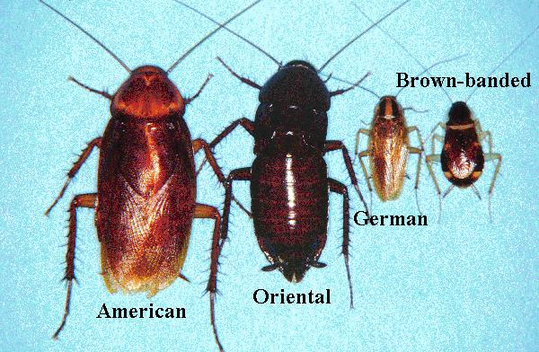

Slide 6
BOOKLICE
Eggs relatively large 2 per day about 100 total per female in crevices.
Nymphs 3-8 weeks to reach maturity feed with adults, adults always female 1-15 mm pale brownish yellow soft bodied appearance - lives about 6 months.
Habit - domestic species prefers warm humid conditions widely found in domestic kitchens and food. Usually found in flour and other cereal products, milk powder but feeding on paper wrapping

Slide 7
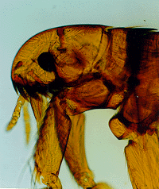
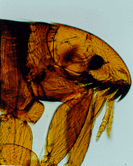
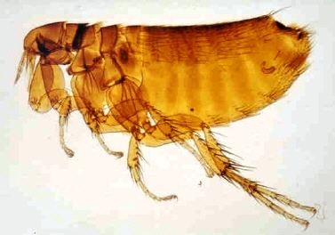
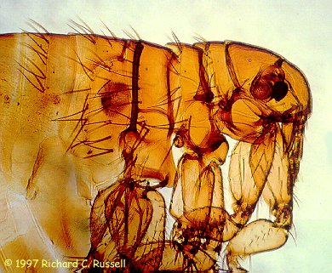
Dog flea
Cat flea
Bird flea
Human flea

Slide 8
FLEAS
Egg – larva – pupa – adult
Eggs – 0.5mm, pearly white. Laid in clothing, bedding or fur of host. Often drop off the host onto the floor or among bedding. Hatch in 2-3 days.
Larvae – legless, whitish up to 5mm long, thrive best in humid places in host bedding or floor.
2-3 moults, fully grown in 3-4 weeks.
Pupa – insubstantial cocoon spun by larva. Development time dependent on temperature. Emergence in response to vibration.
Adults – about 2mm long, shiny dark brown, wingless, laterally flattened and with large hind legs for jumping.

Slide 9
BEDBUGS
Egg – nymph – adult
Eggs – up to 200, possibly more, laid at a rate of 4-5 a day glued in crevices and harbourages. Eggs white with cap. Only hatch above 13°c.
Nymphs – 5 moults, taking from a few weeks to several months depending on food supply and conditions.
Adults – wingless, flattened unless recently fed, about 6mm long.

Slide 10
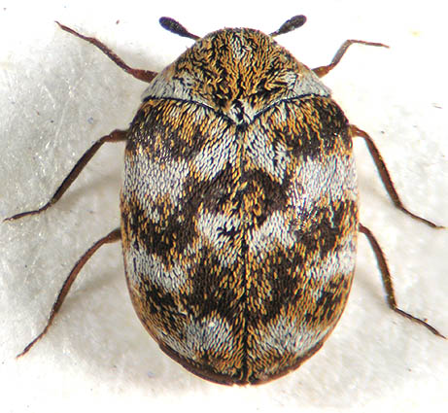
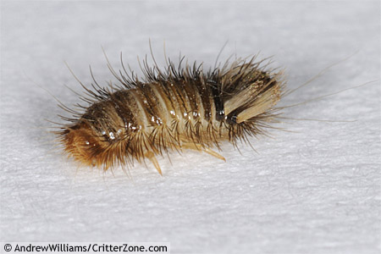
Carpet beetle – Anthrenus verbasci
Adult beetle
Larva – woolly bear- fabric feeder

Slide 11
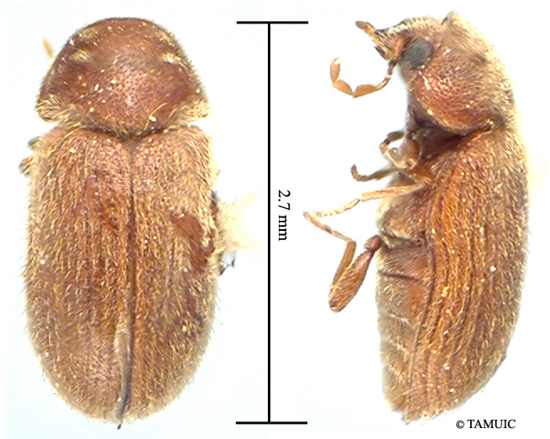
Woodworm Biscuit beetle
Often confused in the adult state – the woodworm is the ‘hoodie’

Slide 12
AUSTRALIAN SPIDER BEETLE
Eggs – whitish, up to 200 per female, 6-50 per week on or near larval food.
Larvae – white with brown head active when first hatched, can penetrate packaging sacks to enter food stuff. Become grub-like and immobile when bigger.
Pupae – in cocoon’s often in clusters or lines near food.
Adults 3-4mm, mid brown clusters in groups during the day on sacks and between floor boards wander at night to feed – cannot fly.
Notes:
Habit: One of the family called spider beetles. This species originally Tasmanian origin but established in the UK in 1800’s. Indoor warehouse and food storage scavenger, often in bird’s nests. Prefer food of high animal protein content.
Importance: Food storage pest attacking cereal products, dried fruit, pulses, spices, dog biscuits. Larvae damage packaging.
Control: Find breeding sites, remove old bird’s nests. Proofing, good hygiene, stock rotation. Residual sprays or dusts.

Slide 13
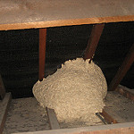
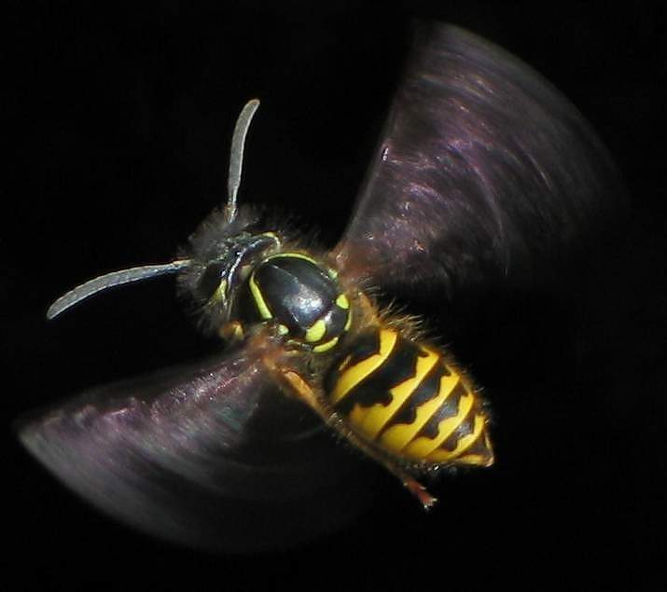
Queen wasp produces
a single nest per year and
multiple successors.

